Slide 1
How does the relationship between AI adoption and economic growth vary across levels of economic development?
03.06.2026.
Mátyás Varga-Etele
Bachelor’s Thesis Presentation

Slide 2
Research Motivation
AI may increase productivity and economic growth.
However, the benefits may not be distributed equally.
Developed economies may be better positioned to benefit from AI.

Slide 3
Research Question and Hypothesis
Research Question:
How does the relationship between AI adoption and economic growth vary across levels of economic development?
Hypothesis:
AI’s effect on economic growth becomes more positive at higher levels of economic development.

Slide 4
Theoretical Framework
Endogenous growth theory.
AI as a general-purpose technology.
Technological diffusion theory.
AI and global inequality.

Slide 5
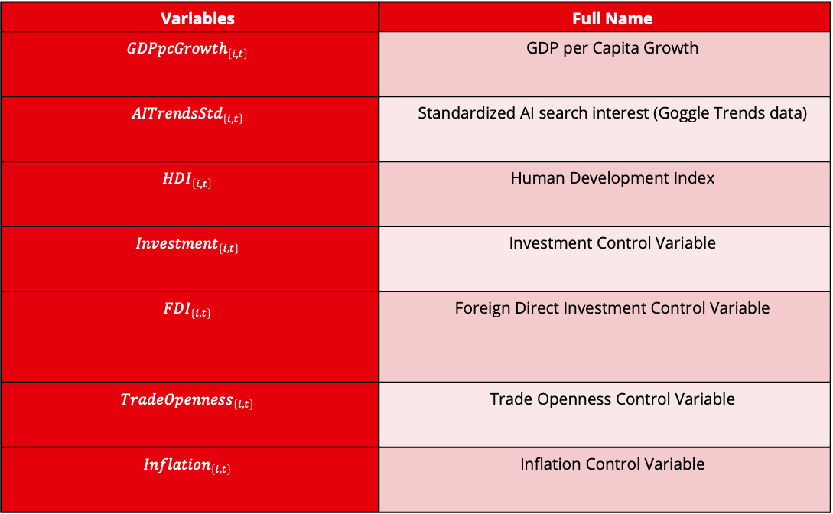
Data and Methodology
Variables Table
Panel data: 2004–2024
Dependent variable: real GDP per capita growth
AI proxy: Google Trends for “artificial intelligence”
Development measure: HDI
Model: country and year fixed effects, clustered standard errors
Variables | Full Name
$$GDPpcGrowth_{\left\{i,t\right\}}$$ | GDP per Capita Growth
$$AITrendsStd_{\left\{i,t\right\}}$$ | Standardized AI search interest (Goggle Trends data)
$$HDI_{\left\{i,t\right\}}$$ | Human Development Index
$$Investment_{\left\{i,t\right\}}$$ | Investment Control Variable
$$FDI_{\left\{i,t\right\}}$$ | Foreign Direct Investment Control Variable
$$TradeOpenness_{\left\{i,t\right\}}$$ | Trade Openness Control Variable
$$Inflation_{\left\{i,t\right\}}$$ | Inflation Control Variable

Slide 6
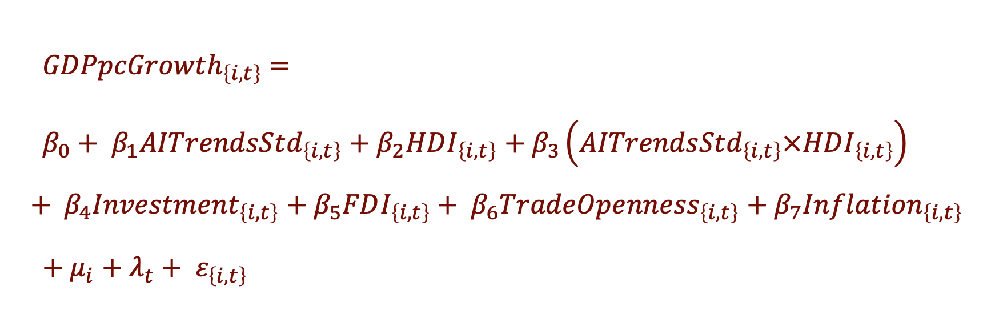
Regression Specification
$GDPpcGrowth_{\left\{i,t\right\}}$ $=$
$β_{0}+ β_{1}AITrendsStd_{\left\{i,t\right\}}$ $+ β_{2}HDI_{\left\{i,t\right\}}$ $+ β_{3}\left.\left(AITrendsStd_{\left\{i,t\right\}}×HDI_{\left\{i,t\right\}}\right.\right)$ $+ β_{4}Investment_{\left\{i,t\right\}}$ $+ β_{5}FDI_{\left\{i,t\right\}}+ β_{6}TradeOpe{nness}_{\left\{i,t\right\}}$ $+ β_{7}Inflation_{\left\{i,t\right\}}$
$+ μ_{i}$ $+ λ_{t}+ ε_{\left\{i,t\right\}}$

Slide 7
Main Regression Results
Regression Table
AI Trends alone is not statistically significant.
Interaction term between AI Trends and HDI is positive but not statistically significant.
Investment, trade openness, and inflation are significant controls.
Variable | (1) Baseline Model | (2) Extended Model
AI trends | -0.177 | -0.829
HDI | 0.049 | 1.942
AI trends × HDI |  | 0.968
Investment | 0.142*** | 0.140***
FDI | 0.005 | 0.005
Trade openness | 0.048*** | 0.046***
Inflation | -0.018*** | -0.017***

Slide 8
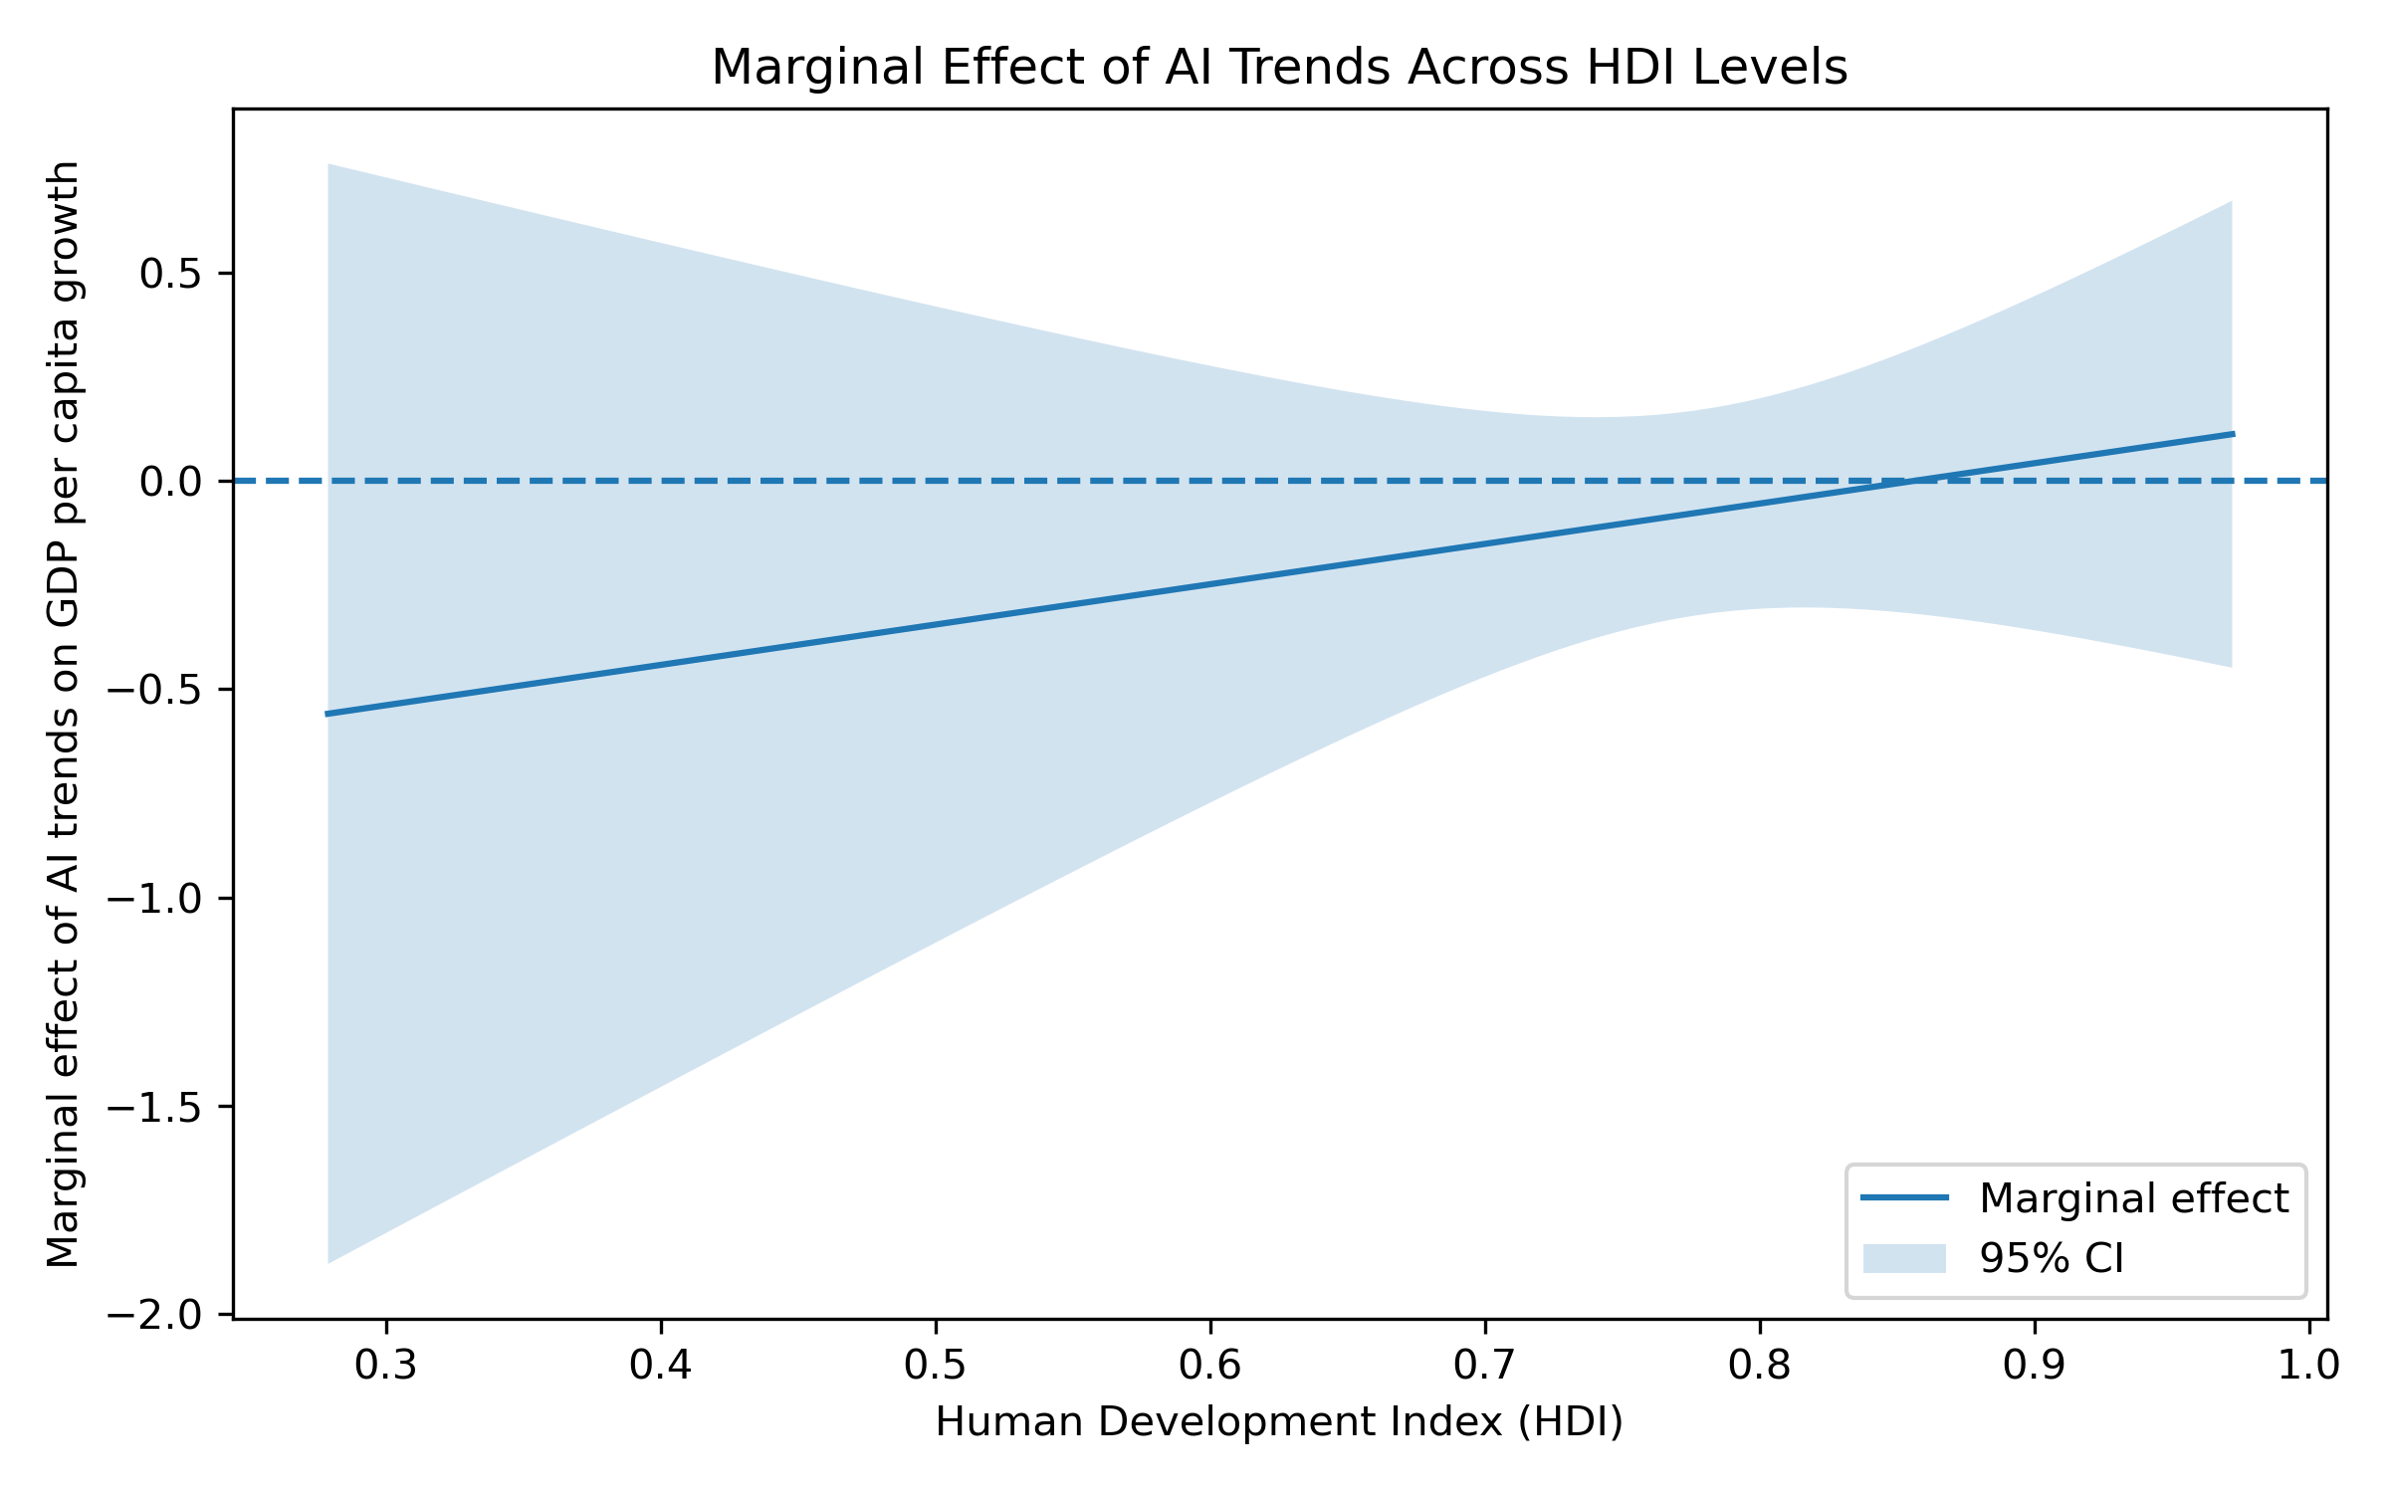
Marginal Effects of AI Adoption
The marginal effect becomes less negative as HDI increases.
At high HDI levels, the effect approaches zero.
This provides suggestive evidence for the hypothesis.

Slide 9
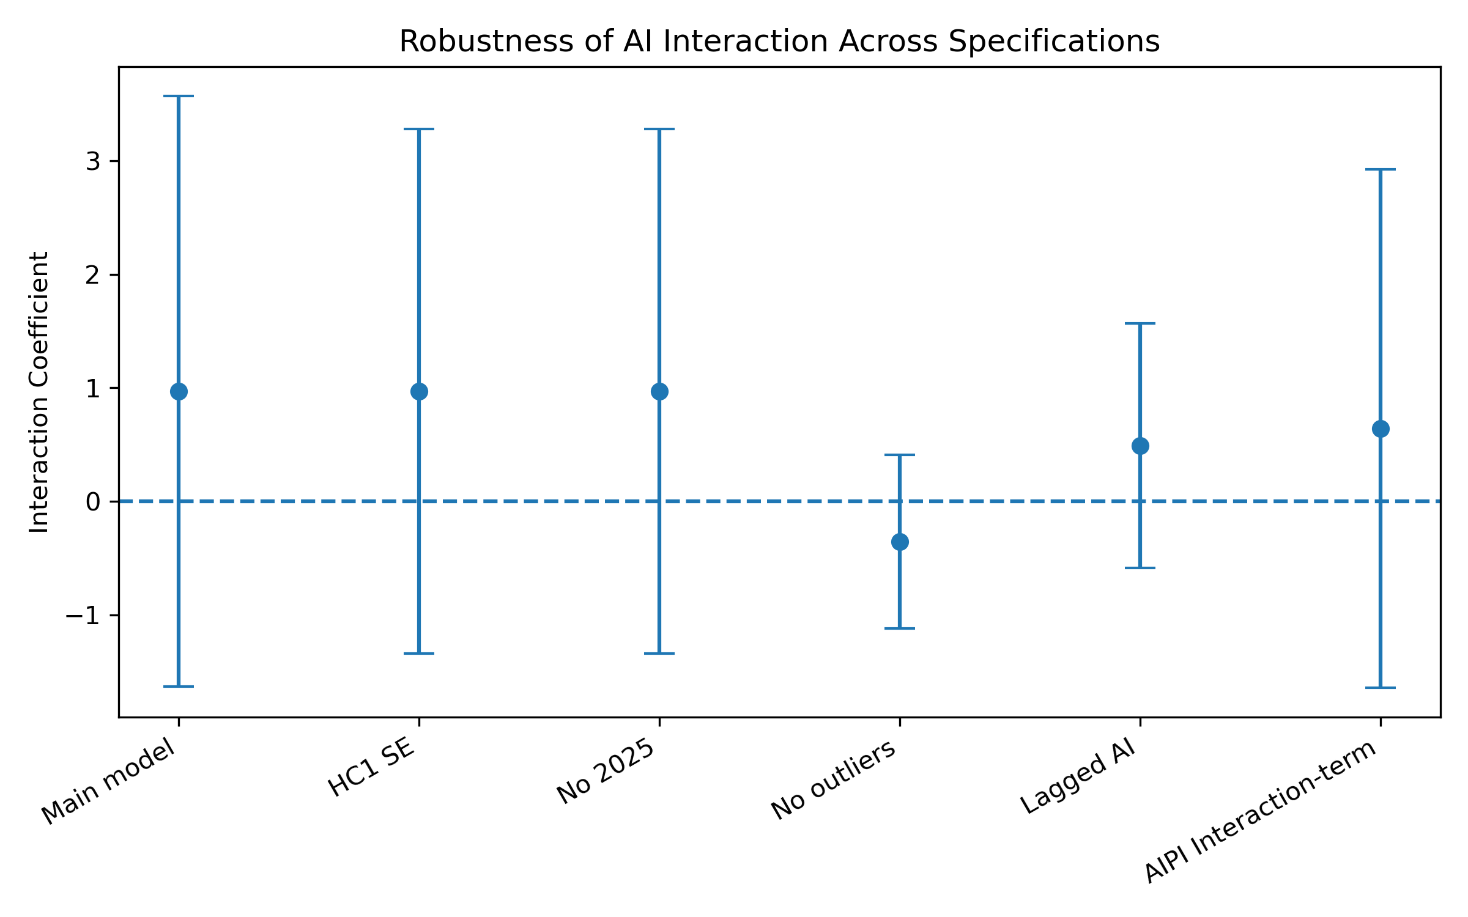
Robustness Checks
The interaction coefficient remains positive in most specifications, although confidence intervals remain wide.
Excluding extreme GDP growth outliers changes the magnitude of the interaction coefficient, but the overall conclusion remains unchanged due to the wide confidence intervals.

Slide 10
Conclusions
Main Finding
AI-related growth effects become more favourable as economic development increases.
Implication
Developed economies may be better positioned to benefit from AI technologies.
Limitation
Evidence remains limited because the interaction coefficient is not statistically significant and there could be other measures for AI adoption.

Slide 11
Thank You for Listening

